Slide 1
Verilog Design 6.13. Synthesis of Loops
EE417 Logic Design Using FPGAs

Slide 2
6.13 SYNTHESIS of LOOPS
Types of Loops: Static versus nonstatic loops
Loops with or without Embedded timing control
Synthesizable versus Nonsynthesizable loops
Static Loops without embedded timing controls
Static Loops with embedded timing controls
Nonstatic Loops with embedded timing controls
Nonstatic Loops without embedded timing controls
Unsynthesizable loops (Replace them with FSM)

Slide 3
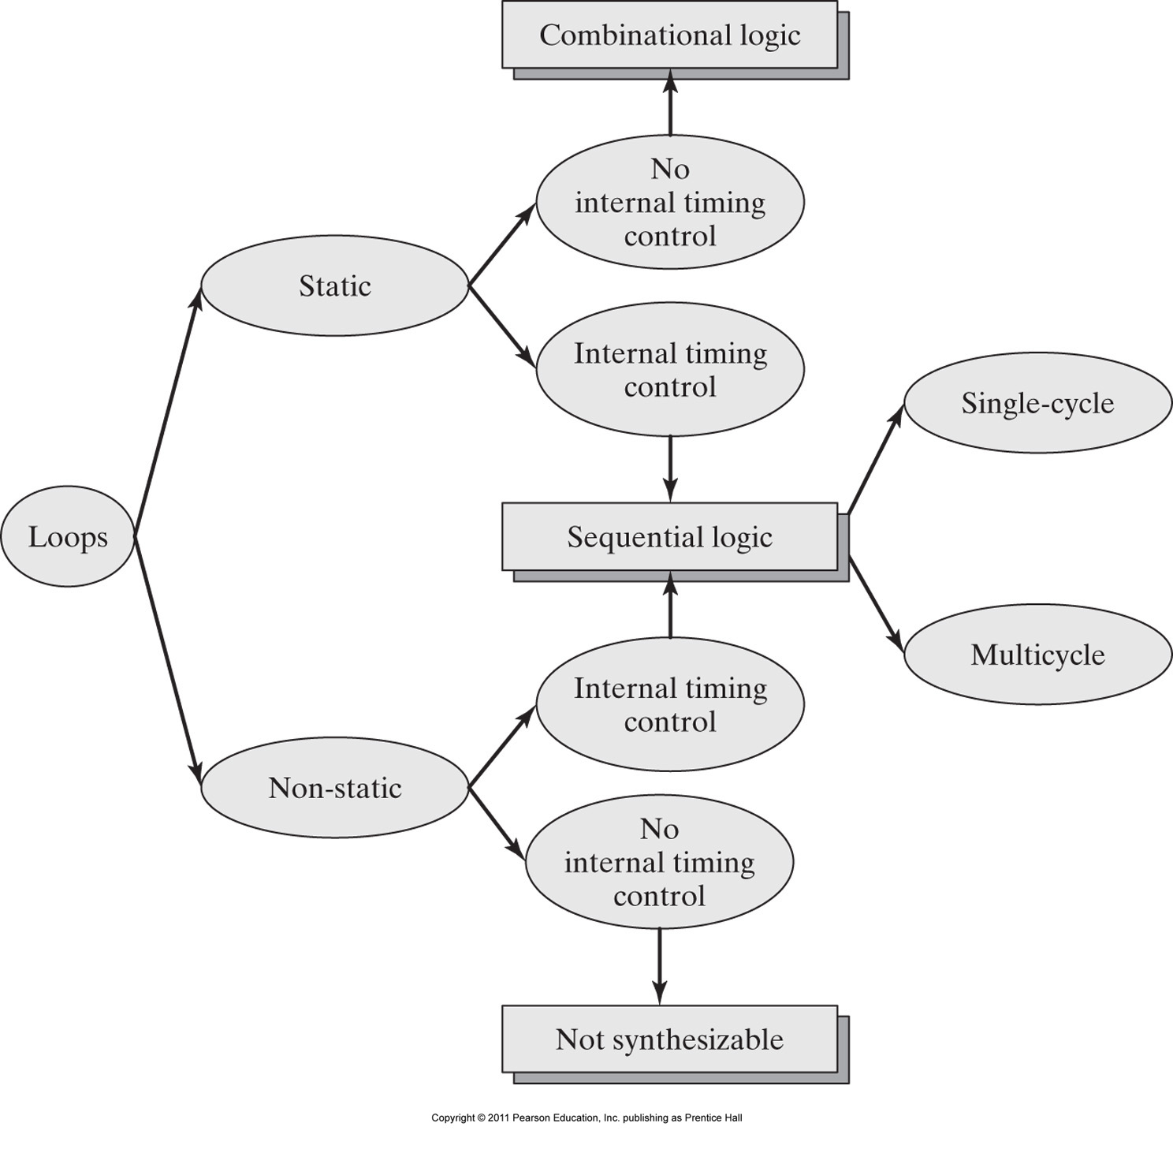
Types of Loops:
A loop in a cyclic behavior is said to be static or data-independent if the number of its iterations can be determined by the compiler before simulation.
The number of iterations is fixed and data-independent. Like for example in a for or repeat loop.

Slide 4
Types of Loops:
A loop in a cyclic behavior is said to be nonstatic or data-dependent if the number of its iterations depends on some input variable during the operation.
The number of iterations is not fixed and data-dependent.

Slide 5
Types of Loops:
A loop in a cyclic behavior may have a dependency on embedded timing controls, i.e. an event control expression (@ posedge clk).

Slide 6
6.13.1. Static Loops without embedded timing controls
The iterative computational sequence can be done in a single step using combinational logic by ‘unrolling’ the loop.

Slide 7
6.13.1. Static Loops without embedded timing controls
module for_loop_comb (output reg [3:0] out,
input [3:0] a,b);
reg [2:0] i;
always @ (a,b) begin
for (i=0; i<= 3; i=i+1)
out[i] = a[i] & b[i];
end
endmodule
// The compiler can unroll the loop as follows:
module for_loop_comb (output reg [3:0] out,
input [3:0] a,b);
// reg [2:0] i;
always @ (a,b) begin
out[0] = a[0] & b[0];
out[1] = a[1] & b[1];
out[2] = a[2] & b[2];
out[3] = a[3] & b[3];
end
endmodule
Fixed number of iterations within the for loop. i goes from 0 to 3 regardless of the data values of the inputs a and b.
There is no internal timing control (no event-control expressions)

Slide 8
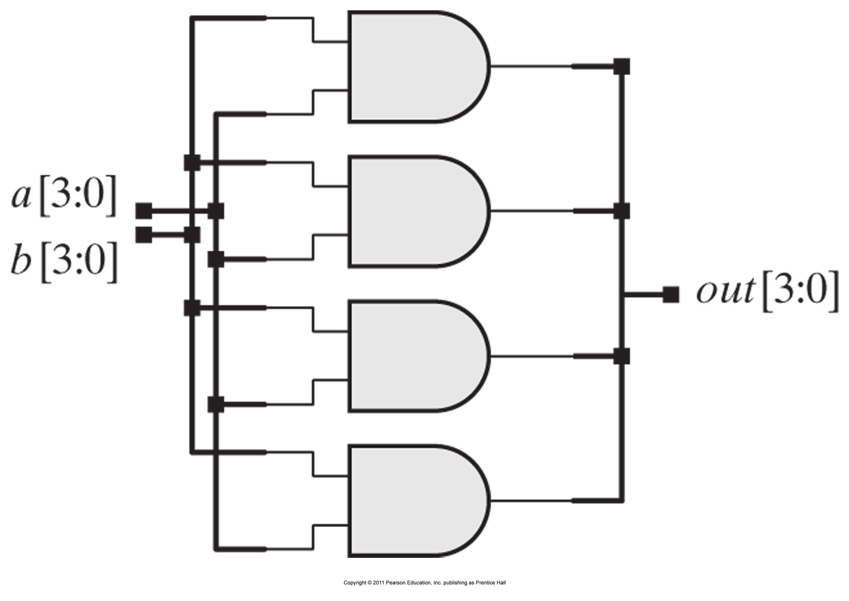
6.13.1. Static Loops without embedded timing controls
module for_loop_comb (output reg [3:0] out,
input [3:0] a,b);
reg [2:0] i;
always @ (a,b) begin
for (i=0; i<= 3; i=i+1)
out[i] = a[i] & b[i];
end
endmodule
The module is mainly describing a combinationl logic that can be synthesized using a combinational circuit by unrolling the loop.

Slide 9
6.13.1. Static Loops without embedded timing controls
module repeat_loop_comb # ( parameter word_size = 4)
( output reg [3:0] out,
input [3:0] a,b);
reg [2:0] i;
always @ (a,b) begin
i = 0;
repeat (word_size)
out[i] = a[i] & b[i];
i = i+1;
end
endmodule
// The compiler can unroll the loop as follows:
module for_loop_comb (output reg [3:0] out,
input [3:0] a,b);
// reg [2:0] i;
always @ (a,b) begin
out[0] = a[0] & b[0];
out[1] = a[1] & b[1];
out[2] = a[2] & b[2];
out[3] = a[3] & b[3];
end
endmodule

Slide 10
6.13.1. Static Loops without embedded timing controls
module count_ones_a (bit_count, data, clk, reset);
parameter data_width = 4;
parameter count_width = 3;
output reg [count_width-1: 0] bit_count;
input [data_width-1: 0] data;
input clk, reset;
reg [count_width-1: 0] count, index;
reg [data_width-1: 0] temp;
always @ (posedge clk)
if (reset) begin count = 0; bit_count = 0; end
else begin
count = 0;
bit_count = 0;
temp = data;
for (index = 0; index < data_width; index = index + 1)
begin
count = count + temp[0];
temp = temp >> 1;
end
bit_count = count;
end
endmodule
Fixed number of iterations within the for loop. (Depends on the fixed data width not the data values).
There is no internal timing control (no event-control expressions) within the loop.
Blocking assignments (combinational logic).

Slide 11
module count_ones_a (bit_count, data, clk, reset);
parameter data_width = 4;
parameter count_width = 3;
output reg [count_width-1: 0] bit_count;
input [data_width-1: 0] data;
input clk, reset;
reg [count_width-1: 0] count, index;
reg [data_width-1: 0] temp;
always @ (posedge clk)
if (reset) begin count = 0; bit_count = 0; end
else begin
count = 0;
bit_count = 0;
temp = data;
for (index = 0; index < data_width; index = index + 1)
begin
count = count + temp[0];
temp = temp >> 1;
end
bit_count = count;
end
endmodule
temp and index will be eliminated by the synthesis tool.
// unrolled loop
module count_ones_a (bit_count, data, clk, reset);
output reg [2:0] bit_count;
input [3: 0] data;
input clk, reset;
wire [2:0] count;
/* bit_count needs a FF to update at the
positive clock edge */
always @ (posedge clk)
if (reset) bit_count <= 0;
else bit_count <= count;
// Combinational logic to add the data bits
Four_bit_adder M1 (count, data[3], data[2]
data[1], data[0]);
endmodule

Slide 12
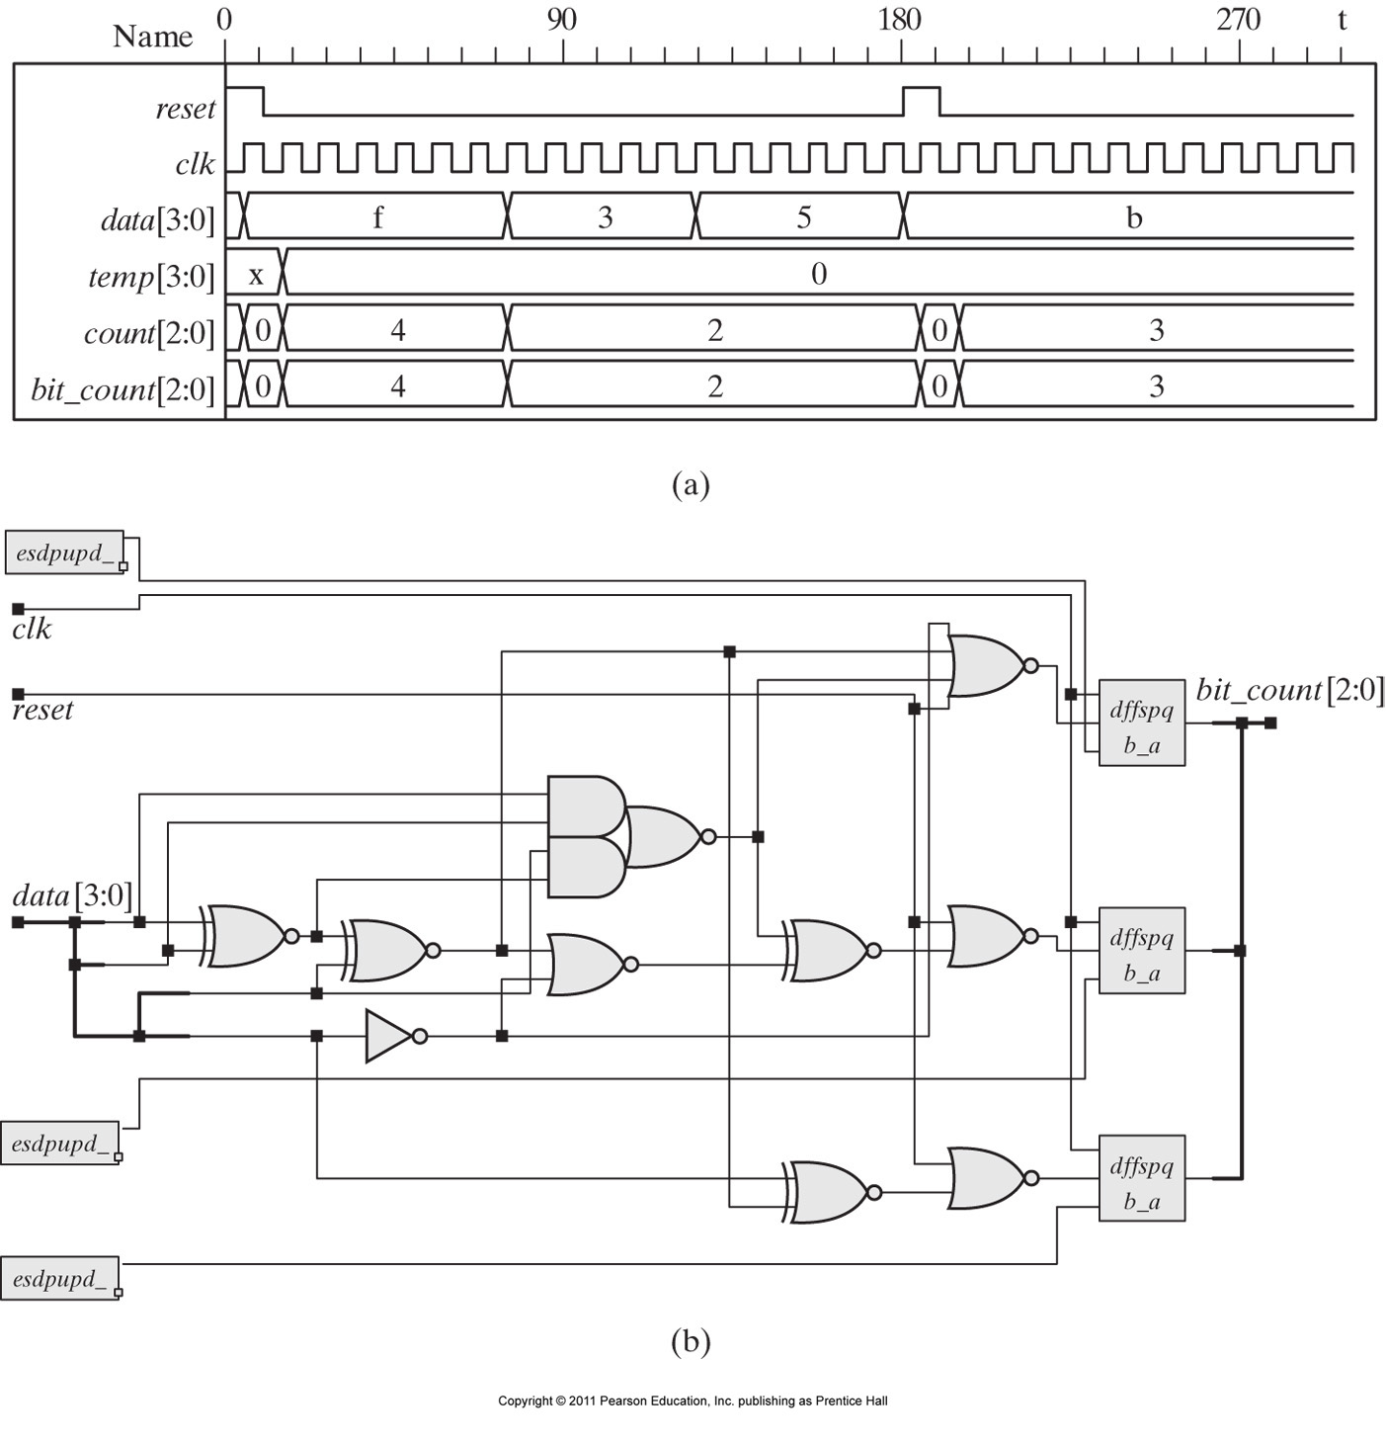
The bit_count updates within the same clock cycle in which the loop executes (instantaneously) indicating the number of 1 bits in the updated data.
Only final values are showing. (The intermediate steps don’t show)
Combinational Logic implementing the 4-bit adder
3 D-FF to update the three bits of the bit_count at the positive edge of the clock.

Slide 13
6.13.2. Static Loops with embedded timing controls
The computational activity of the loop is synchronized and distributed over one or more cycles of the clock.
As a static loop, it executes for a fixed number of clock cycles, independently of the data.

Slide 14
6.13.2. Static Loops with embedded timing controls
The loops can be unrolled and controlled by a FSM whose state transitions correspond to the iterations of the loop.

Slide 15
6.13.2. Static Loops with embedded timing controls
module count_ones_b0 # (parameter data_width = 4;
parameter count_width = 3)(
output reg [count_width-1: 0] bit_count;
input [data_width-1: 0] data;
input clk, reset );
reg [count_width-1: 0] count, bit_count;
reg [data_width-1: 0] temp;
integer index;
always @ (posedge clk) begin: machine
if (reset) begin bit_count = 0; disable machine; end
count = 0; bit_count = 0; index = 0; temp = data;
forever @ (posedge clk)
if (reset) begin bit_count = 0; disable machine; end
else if (index < data_width-1) begin
count = count + temp[0];
temp = temp >> 1;
index = index + 1; end
else begin bit_count = count + temp[0];
disable machine; end
end
endmodule
The same example counting the number of ones in the data, using the forever loop.

Slide 16
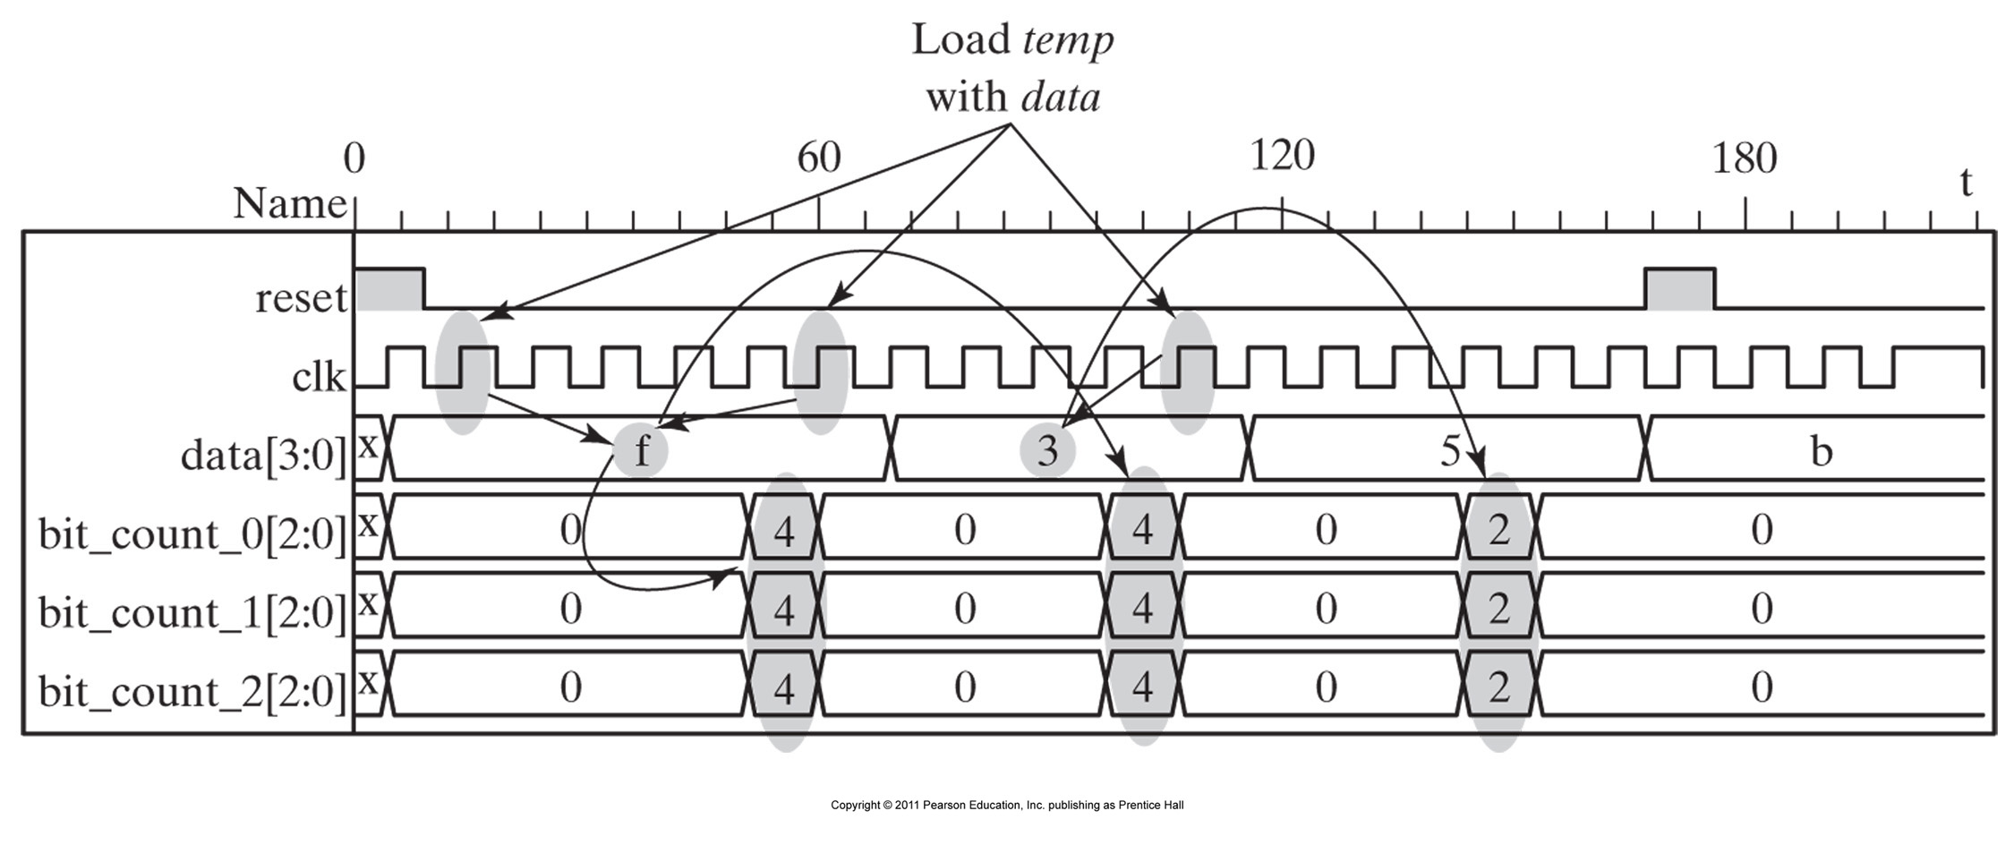
module count_ones_b0 # (parameter data_width = 4;
parameter count_width = 3)(
output reg [count_width-1: 0] bit_count;
input [data_width-1: 0] data;
input clk, reset );
reg [count_width-1: 0] count, bit_count;
reg [data_width-1: 0] temp;
integer index;
always @ (posedge clk) begin: machine
if (reset) begin bit_count = 0; disable machine; end
count = 0; bit_count = 0; index = 0; temp = data;
forever @ (posedge clk)
if (reset) begin bit_count = 0; disable machine; end
else if (index < data_width-1) begin
count = count + temp[0];
temp = temp >> 1;
index = index + 1; end
else begin bit_count = count + temp[0];
disable machine; end
end
endmodule
@(posedge clk)
index = 0
index = 3
index = 2
bit_count = count+temp[0]
index = 1

Slide 17
6.13.2. Static Loops with embedded timing controls
module count_ones_b1 # (parameter data_width = 4;
parameter count_width = 3)(
output reg [count_width-1: 0] bit_count;
input [data_width-1: 0] data;
input clk, reset );
reg [count_width-1: 0] count, bit_count;
reg [data_width-1: 0] temp;
integer index;
always @ (posedge clk) begin: machine
if (reset) begin bit_count = 0; disable machine; end
else begin count = 0; bit_count = 0; index = 0; temp = data;
while (index < data_width-1) begin
if (reset) begin bit_count = 0; disable machine; end
else if ( (index < data_width)&& (temp[0]))
count = count + 1;
temp = temp >> 1;
index = index + 1;
@ (posedge clk) end
if (reset) begin bit_count = 0; disable machine; end
else bit_count = count; disable machine;
end
endmodule
The same example counting the number of ones in the data, using the while loop.

Slide 18
module count_ones_b0 # (parameter data_width = 4;
parameter count_width = 3)(
output reg [count_width-1: 0] bit_count;
input [data_width-1: 0] data;
input clk, reset );
reg [count_width-1: 0] count, bit_count;
reg [data_width-1: 0] temp;
integer index;
always @ (posedge clk) begin: machine
if (reset) begin bit_count = 0; disable machine; end
else begin count = 0; bit_count = 0; index = 0; temp = data;
while (index < data_width-1) begin
if (reset) begin bit_count = 0; disable machine; end
else if ( (index < data_width)&& (temp[0]))
count = count + 1;
temp = temp >> 1;
index = index + 1;
@ (posedge clk) end
if (reset) begin bit_count = 0; disable machine; end
else bit_count = count; disable machine;
end
endmodule
@(posedge clk)
index = 0
index = 4
index = 3
index = 2
index = 1
bit_count = count

Slide 19
6.13.2. Static Loops with embedded timing controls
module count_ones_b2 # (parameter data_width = 4;
parameter count_width = 3)(
output reg [count_width-1: 0] bit_count;
input [data_width-1: 0] data;
input clk, reset );
reg [count_width-1: 0] count, bit_count;
reg [data_width-1: 0] temp;
integer index;
always begin: machine
for (index = 0; index <= data_width; index = index +1) begin
@ (posedge clk)
if (reset) begin bit_count = 0; disable machine; end
else if (index == 0)
begin count = 0; bit_count = 0; temp = data; end
else if (index < data_width) begin
count = count + temp[0];
temp = temp >>1; end
else bit_count = count + temp[0];
end
end
endmodule
The same example counting the number of ones in the data, using the for loop.

Slide 20
module count_ones_b0 # (parameter data_width = 4;
parameter count_width = 3)(
output reg [count_width-1: 0] bit_count;
input [data_width-1: 0] data;
input clk, reset );
reg [count_width-1: 0] count, bit_count;
reg [data_width-1: 0] temp;
integer index;
always begin: machine
for (index = 0; index <= data_width; index = index +1) begin
@ (posedge clk)
if (reset) begin bit_count = 0; disable machine; end
else if (index == 0)
begin count = 0; bit_count = 0; temp = data; end
else if (index < data_width) begin
count = count + temp[0];
temp = temp >>1; end
else bit_count = count + temp[0];
end
end
endmodule
index = 0
index = 4
index = 3
index = 2
index = 1
bit_count = count + temp[0]

Slide 21
Can you write the equivalent FSM that unrolls the static loops?
module count_ones_FSM (output reg [2:0] bit_count;
input [data_width-1: 0] data;
input clk, reset );
reg [2:0] count;
reg [2:0] state, next_state;
always @ (posedge clk)
state <= next_state;
always @ *
case (state)
0 : begin bit_count = 0; count = 0;
if (reset) next_state = 0 else next_state = 1; end
1 : begin bit_count = 0; if (reset) next_state = 0;
else begin next_state = 2; count = count + data[0]; end
2 : begin bit_count = 0; if (reset) next_state = 0;
else begin next_state = 3; count = count + data[1]; end
3 : begin bit_count = 0; if (reset) next_state = 0
else begin next_state = 4; count = count + data[2]; end
4 : begin next_state = 0
if (reset) bit_count = 0;
else bit_count = count + data[3]; end
endmodule
An equivalent FSM

Slide 22
6.13.3. NonStatic Loops without embedded timing controls
The number of iterations to be executed by a loop having a data dependency cannot be determined before simulation.
If the loop does not have an embedded timing control, the behavior can be simulated but it cannot be synthesized.

Slide 23
6.13.3. NonStatic Loops without embedded timing controls
For a simulator the behavior is virtually procedural and can be simulated, but hardware cannot execute the computation of the loop in a single clock cycle.

Slide 24
6.13.3. NonStatic Loops without embedded timing controls
module count_ones_c # (parameter data_width = 4;
parameter count_width = 3)(
output reg [count_width-1: 0] bit_count;
input [data_width-1: 0] data;
input clk, reset );
reg [count_width-1: 0] count, index;
reg [data_width-1: 0] temp;
always @ (posedge clk)
if (reset) begin count = 0; bit_count = 0; end
else begin
count = 0;
temp = data;
for (index = 0; | temp; index = index + 1) begin
if (temp[0] ) count = count + 1;
temp = temp >> 1;
end
bit_count = count;
end
endmodule
The computational activity of counting 1s is stopped after counting the last 1 (using the reduction-or operator).
More Efficient in simulation BUT cannot be unrolled statically!

Slide 25
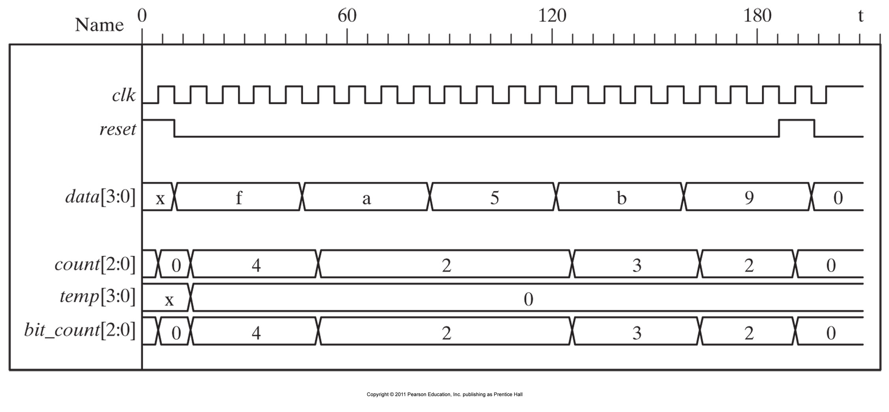
module count_ones_c # (parameter data_width = 4;
parameter count_width = 3)(
output reg [count_width-1: 0] bit_count;
input [data_width-1: 0] data;
input clk, reset );
reg [count_width-1: 0] count, index;
reg [data_width-1: 0] temp;
always @ (posedge clk)
if (reset) begin count = 0; bit_count = 0; end
else begin
count = 0;
temp = data;
for (index = 0; | temp; index = index + 1) begin
if (temp[0] ) count = count + 1;
temp = temp >> 1;
end
bit_count = count;
end
endmodule
The simulator completes the loop iterartion in one clock cycle, this is not possible in hardware as the loop cannot be statically unrolled due to the data dependency!!

Slide 26
6.13.4. NonStatic Loops with embedded timing controls
The data dependency is not a barrier to synthesis, however the iterations of a nonstatic loop must be separated by a synchronizing edge-sensitive event control expression in order to be distributed over multiple clock cycles and become synthesizable.

Slide 27
6.13.4. NonStatic Loops with
embedded timing controls
module count_ones_d # ( parameter data_width = 4;
parameter count_width = 3)(
output reg [count_width-1: 0] bit_count;
input [data_width-1: 0] data;
input clk, reset) ;
reg [count_width-1: 0] count;
reg [data_width-1 : 0] temp;
always begin: wrapper_for_synthesis
@ (posedge clk)
if (reset) begin count = 0; bit_count = 0; end
else begin: bit_counter
count = 0; temp = data;
while (temp)
@ (posedge clk)
if (reset) begin count = 2’b0;
disable bit_counter; end
else begin count = count + temp[0];
temp = temp >> 1; end
if (reset) begin count = 0; disable bit_counter; end
else bit_count = counter;
end // bit_counter
end // wrapper for synthesis
endmodule
Edge-sensitive timing control within the nonstatic while loop.
The sequential activity of the loop is distributed over multiple clock cycles.

Slide 28
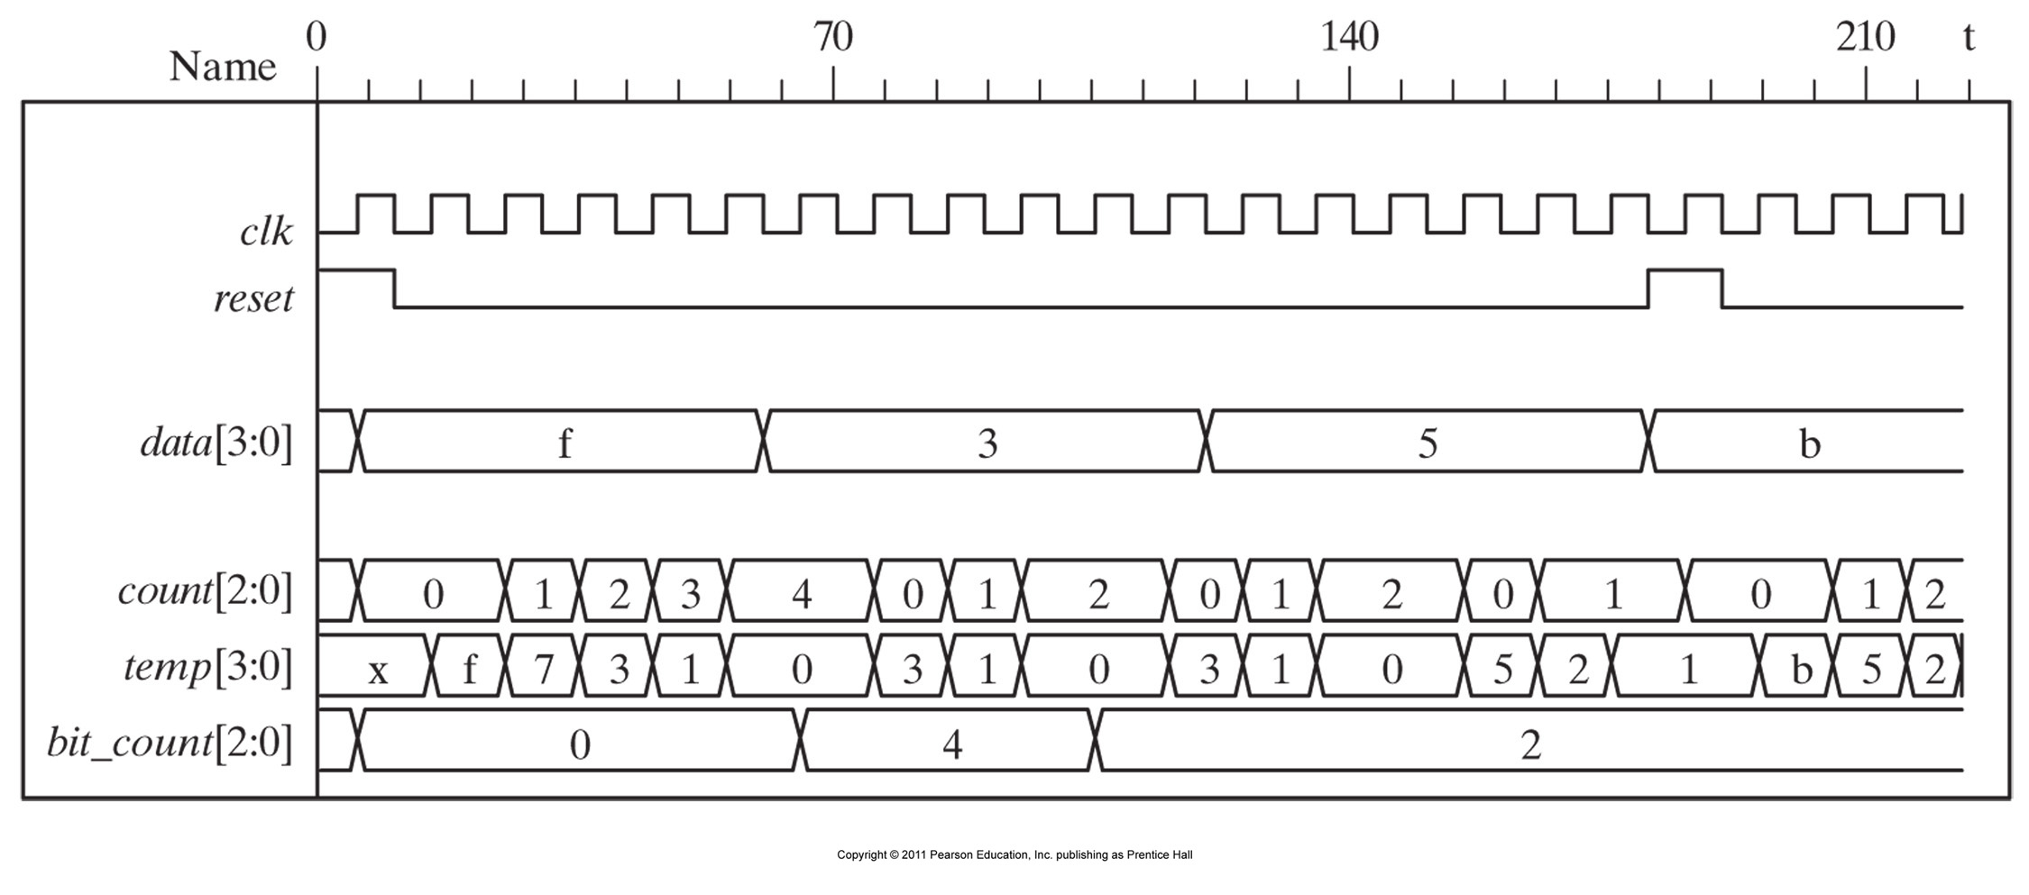
always begin: wrapper_for_synthesis
@ (posedge clk)
if (reset) begin count = 0; bit_count = 0; end
else begin: bit_counter
count = 0; temp = data;
while (temp)
@ (posedge clk)
if (reset) begin
count = 2’b0;
disable bit_counter; end
else begin count = count + temp[0];
temp = temp >> 1;
end
if (reset) begin
count = 0;
disable bit_counter; end
else bit_count = count;
end // bit_counter
end // wrapper for synthesis
For a data of ‘3’ the while loop needs 2 clock cycles only and one extra clock cycle to update bit_count.
For a data of ‘f’ the while loop needs 4 clock cycles to add all the ones in all the data bits to the count register. An extra clock cycle is needed to update bit_count with the final count value

Slide 29
6.13.5.
Replacing Unsynthesizable nonstatic loops
with
synthesizable
FSM using flag
registers.
module count_ones_IMP #(parameter word_size = 4; parameter counter_size = 3)
(output reg [counter_size -1 : 0] bit_count;
output reg start, done;
input [word_size-1: 0] data;
input data_ready, clk, reset ) ;
reg [word_size-1: 0] temp;
always @ (posedge clk)
if (reset) begin
temp<= 0; bit_count <= 0; done <= 0; start <= 0; end
else if (data_ready && data && !temp) begin
temp <= data; bit_count <= 0; done <= 0; start <= 1; end
else if (data_ready && (!data) && !temp) begin
bit_count <= 0; done <= 1; end
else if (temp == 1) begin
bit_count <= bit_count + temp[0];
temp <= temp >> 1;
done <=1; end
else if (temp && !done) begin
start <= 0; temp <= temp >> 1;
bit_count <= bit_count + temp[0]; end
endmodule

Slide 30
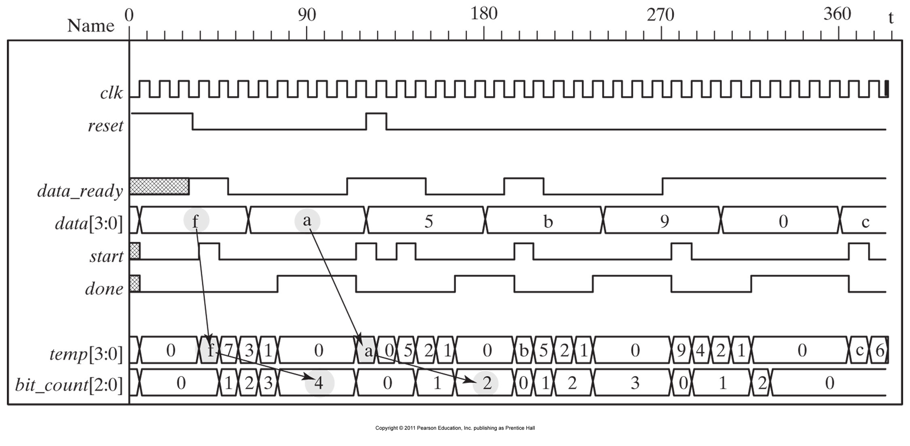
always @ (posedge clk)
if (reset) begin
temp<= 0;
bit_count <= 0;
done <= 0;
start <= 0; end
else if
(data_ready && data && !temp) begin
temp <= data;
bit_count <= 0;
done <= 0;
start <= 1; end
else if
(data_ready && (!data) && !temp) begin
bit_count <= 0;
done <= 1; end
else if (temp == 1) begin
bit_count <= bit_count + temp[0];
temp <= temp >> 1;
done <=1; end
else if (temp && !done) begin
start <= 0;
temp <= temp >> 1;
bit_count <= bit_count + temp[0]; end
1
1
3
3
2
2

Slide 31
always @ (posedge clk)
if (reset) begin
temp<= 0;
bit_count <= 0;
done <= 0;
start <= 0; end
else if
(data_ready && data && !temp) begin
temp <= data;
bit_count <= 0;
done <= 0;
start <= 1; end
else if
(data_ready && (!data) && !temp) begin
bit_count <= 0;
done <= 1; end
else if (temp == 1) begin
bit_count <= bit_count + temp[0];
temp <= temp >> 1;
done <=1; end
else if (temp && !done) begin
start <= 0;
temp <= temp >> 1;
bit_count <= bit_count + temp[0]; end
0
4
0
4

Slide 32
Homework:
Convert the given code that describes a non-static loop into a finite state machine using a case structure instead of the if-statements. Would this be synthesizable?

